Slide 1
SWOT Analysis

Slide 2
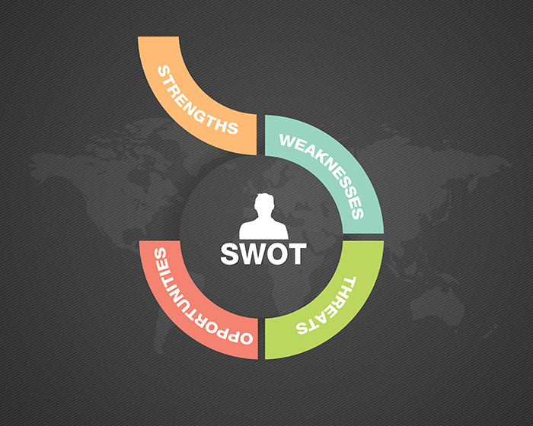

Slide 3
SWOT Analysis
A SWOT analysis is a high-level strategic planning model that helps organizations identify where they’re doing well and where they can improve, both from an internal and external perspective.
It is an acronym for “Strengths, Weaknesses, Opportunities, and Threats.”
Strengths and weaknesses are internal to your company—things that you have some control over and can change.
Opportunities and threats are external—things that are going on outside your company, in the larger marke

Slide 4
Strengths
Start by asking the question, “What are we good at?” This is a broad question, but in the beginning stages of your discussion, you should accept all answers.
Financial Strengths: What is your most reliable source of financial growth? Is it your current customers? A particular product? Your service fee structure?
Customer Strengths: Where is your customer growth coming from? Is this coming from referrals, or a particular industry segment like healthcare or retail? Is it mainly retail or commercial? Why are your customers choosing you over your competitors?
Internal Strengths: What do you do very well as an organization? Are you the first to innovate products in your industry? Do you have strong customer relationships or partnerships?
Learning & Growth Strengths: Where do you excel insofar as your employees are concerned? Is it your compensation model? Could it be your workforce development program? Your culture?

Slide 5
Weaknesses
Next you should ask yourself, “What are we not good at?” or “Where do we have opportunities to improve?”
Financial Weaknesses: What is your biggest financial weakness? Perhaps most of your customers are in a cyclical industry and subject to market urges, for example. Or maybe your most used product has the lowest profit margins.
Customer Weaknesses: Where do your customers think you need to improve? This could be your investment products, locations, loan origination, or competitive prices for interest rates.
Internal Weaknesses: What do you do poorly? Do you have opportunities to improve in project management for opening new branches? What about for one-touch call resolution for customer service?
Learning & Growth Weaknesses: What are your biggest challenges with employees? Do you have particularly high turnover in certain departments or a negative perception of the organizational culture?

Slide 6
Opportunities
Financial Opportunities: What is your biggest opportunity to improve your finances? This might be starting a new product line, increasing customer retention, or going after a new geographical area.
Customer Opportunities: Where could you dramatically improve with your customers? Could you improve your online interface? What about cross-selling related products, or better understanding your customers’ purchasing habits?
Internal Opportunities: What processes will drive you well into the future if you could improve upon them? This may entail partnering with a mortgage origination company or developing neighborhood sponsorships.
Learning & Growth Opportunities: What opportunities do you have to leverage staff? For example, do you have cross-training opportunities? Could you make a few tweaks to improve your culture and thus your retention?

Slide 7
Threats
After identifying opportunities, zero in on your biggest threats by asking, “What do we see on the horizon as being potentially harmful to our organization?”
Financial Threats: What threats could seriously impact your financial health? This could be low-cost competitors, a partner entering the banking space, or an overseas banking product.
Customer Threats: What is your biggest concern about your customers? Does one of your competitors offer zero-fee checking that could steal some of your market share? How simple is your customers’ ease of departure?
Internal Threats: What current areas of your business might harm you later? Do you have a new product rollout soon that could potentially fail? Are you struggling through a merger or an office upgrade?
Learning & Growth Threats: What threatens the people within your organization? This could be anything from instability in your customer support department to staff member departures to a department-specific pushback against new technology.

Slide 8
THANKYOU☺☺

